Slide 1
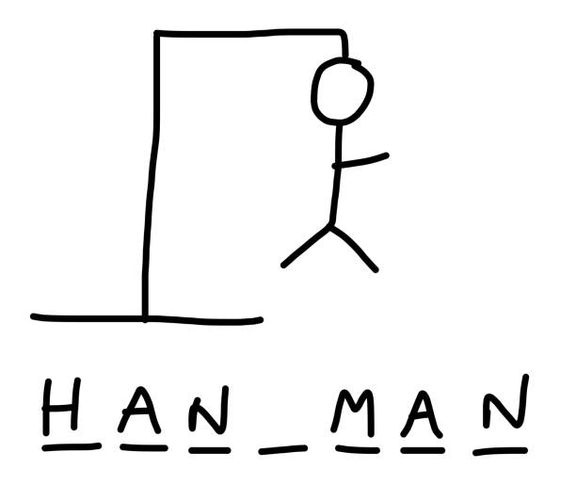
Final Project:
Multi-user Hangman Game
CS 330
Alex Hoerr, Simfara Ranjit, Srushti Desai

Slide 2
Table of Contents
Live demonstration on how our game Hangman works
Server side of the game Hangman
Issues encountered
Client side of the game Hangman
Issues encountered
User Interface of the game Hangman
Issues encountered

Slide 3
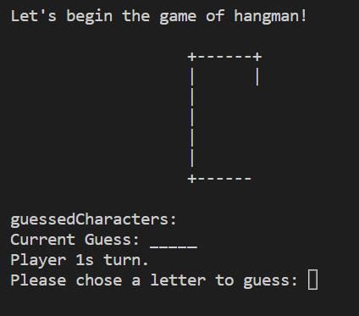

Slide 4
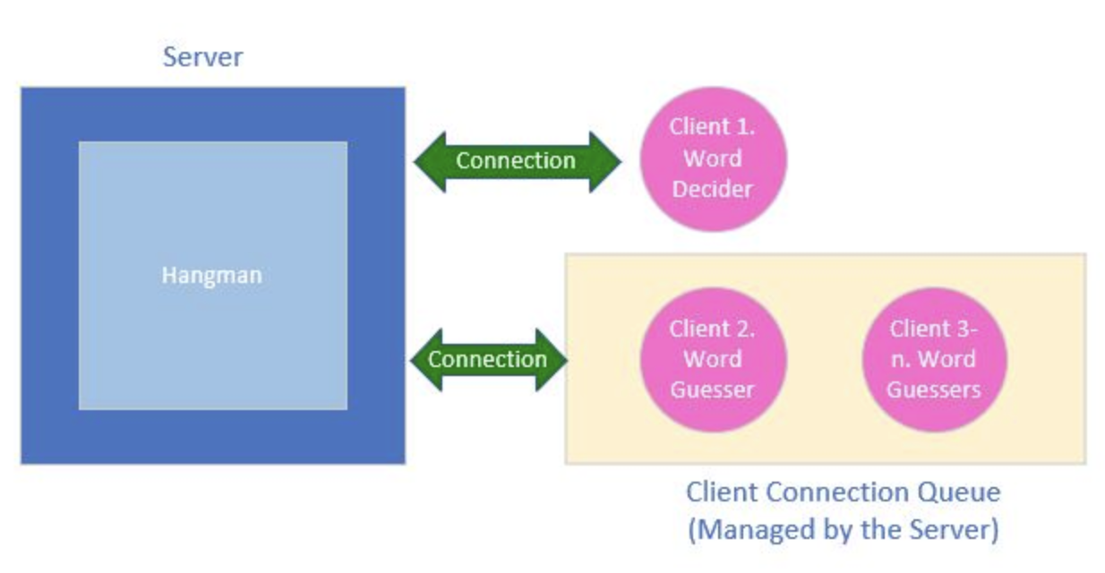
Client-Server Model for Hangman

Slide 5
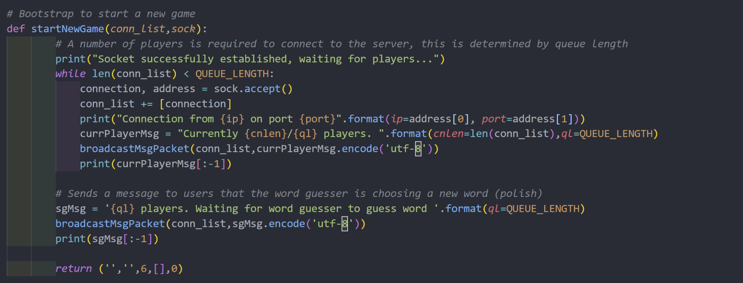
Server Side of the game

Slide 6
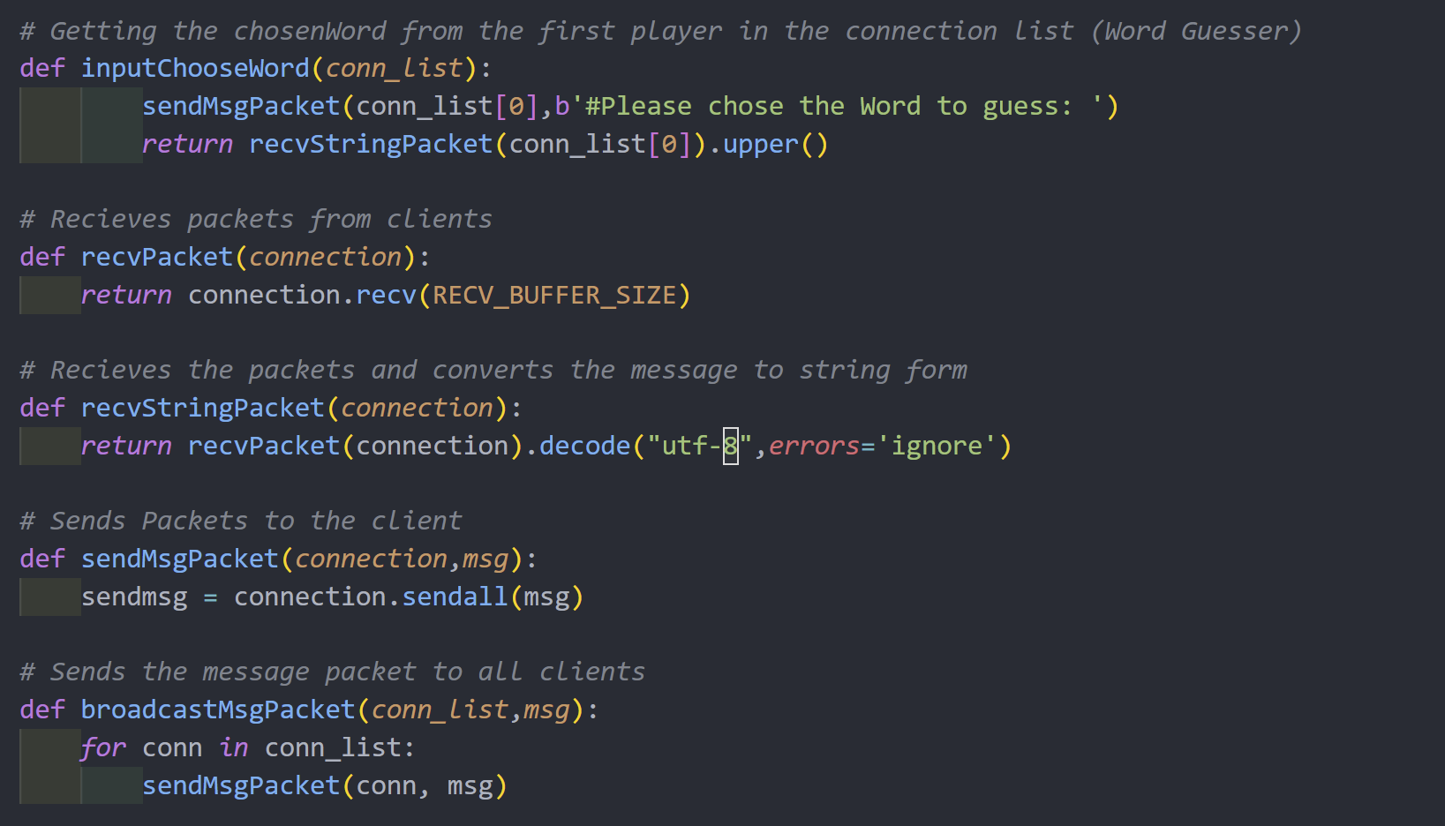
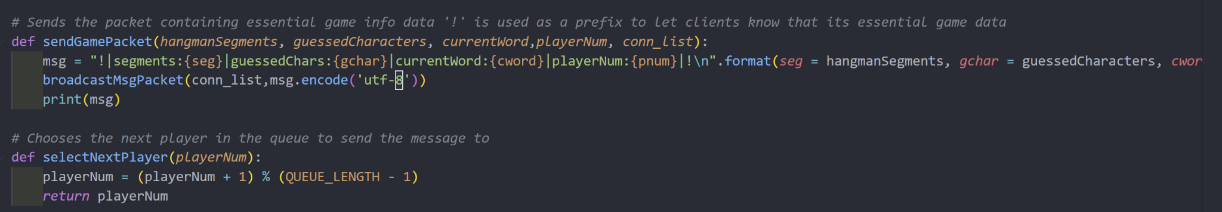

Slide 7
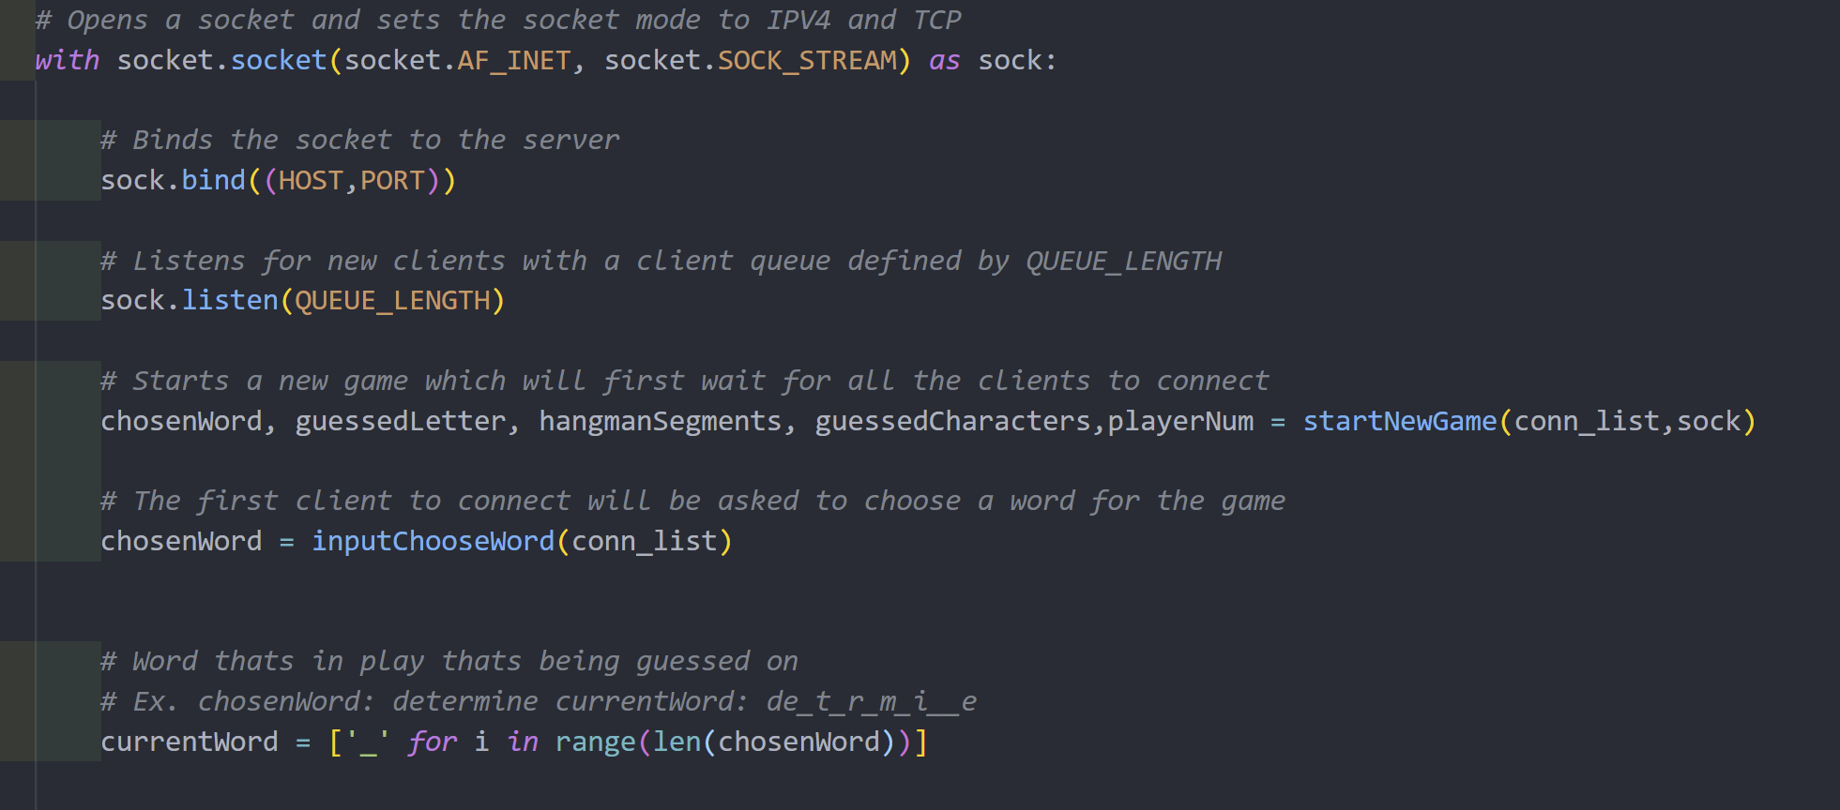

Slide 8
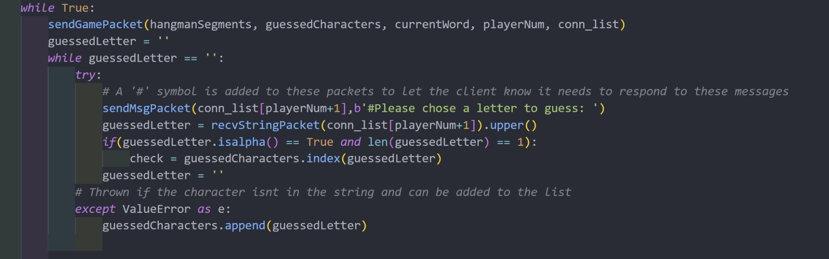

Slide 9
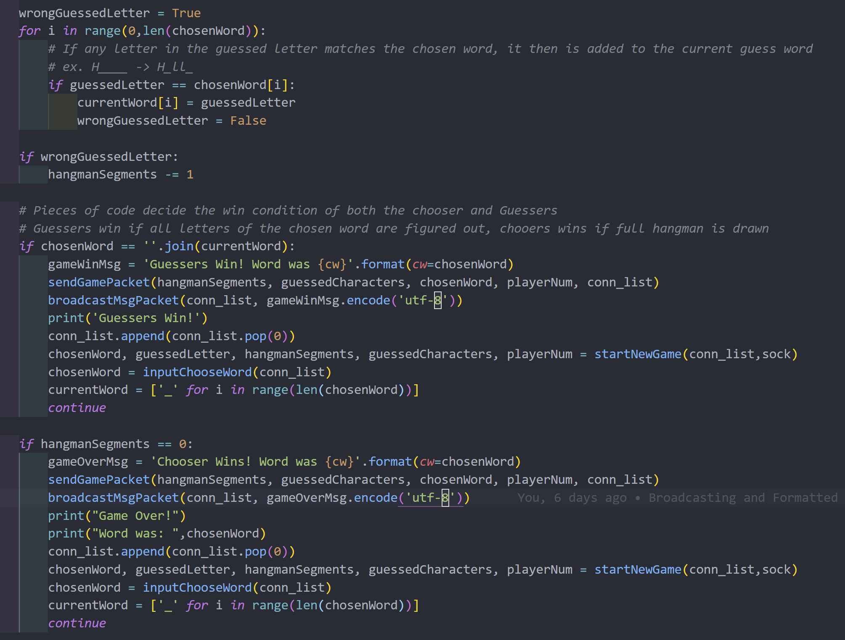

Slide 10
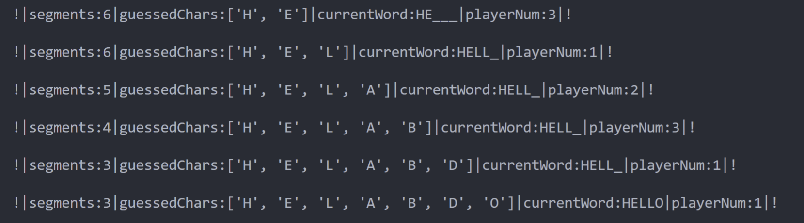
Data Packet
! - Denotes Game Packet
# - Allows the client to input data after reading packet
‘*’ - Packet for top screen info

Slide 11
Issues encountered with Server
Originally Written to not use clients (fixed using functions)
Had to add identifiers to packets
Guessed Character code
How to handle multiple client connections

Slide 12
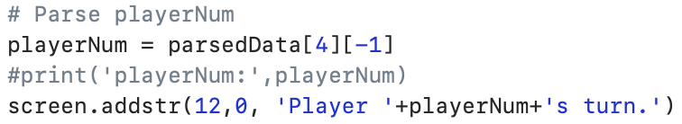
Client Side of the game
Once game has begun, client takes in data from the server about:
Hangman body segments
Guessed characters
Current word
Which players turn it is
Processes data packet from server and displays information.
Uses curses to have a better GUI

Slide 13
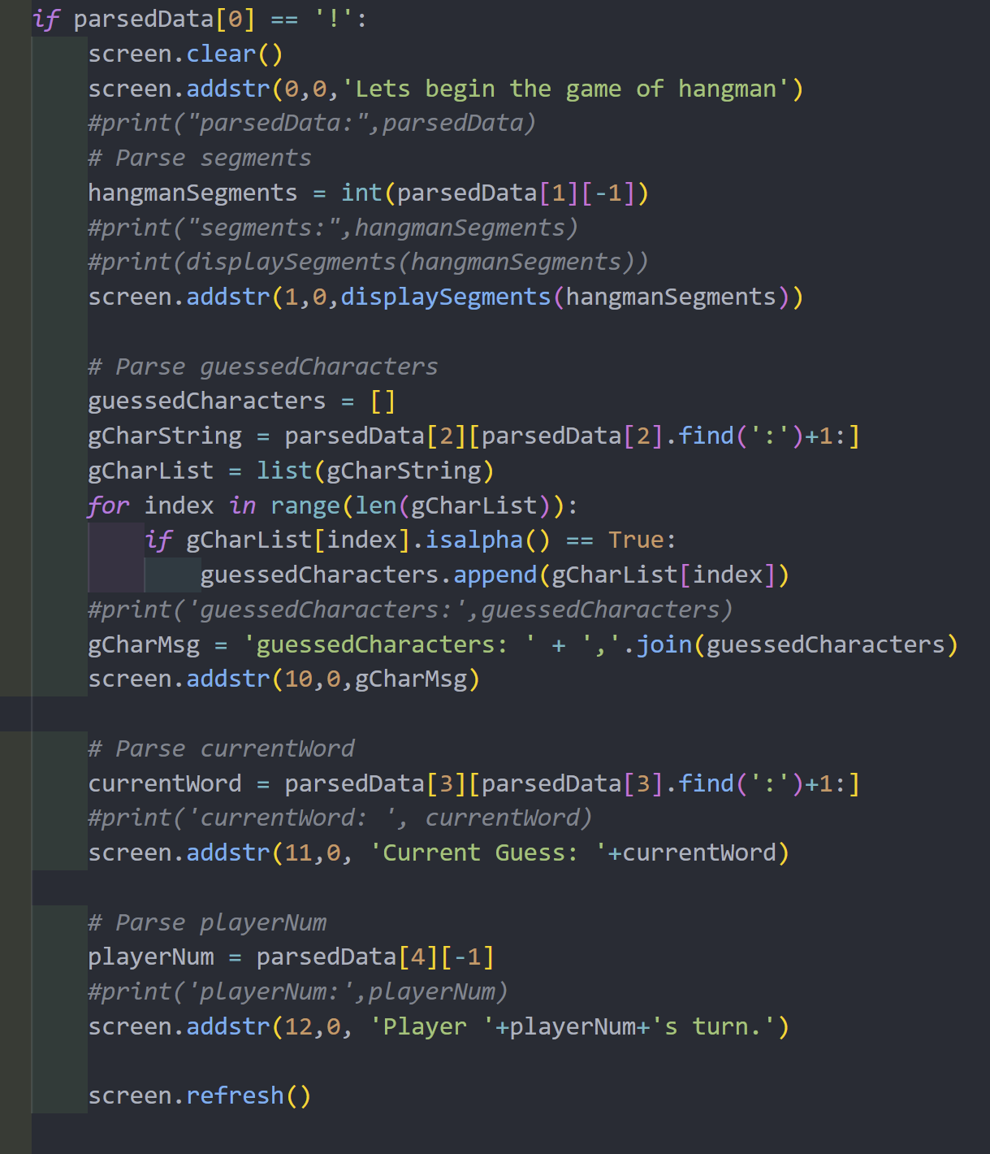
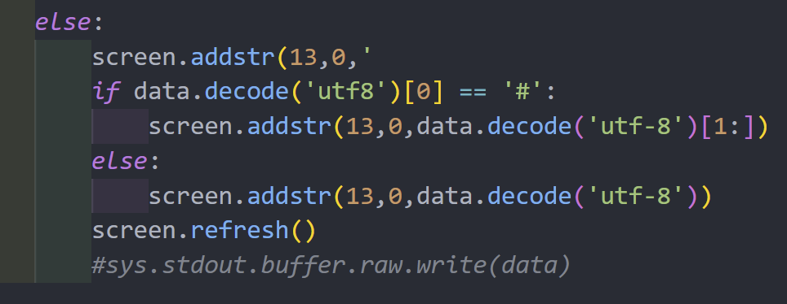
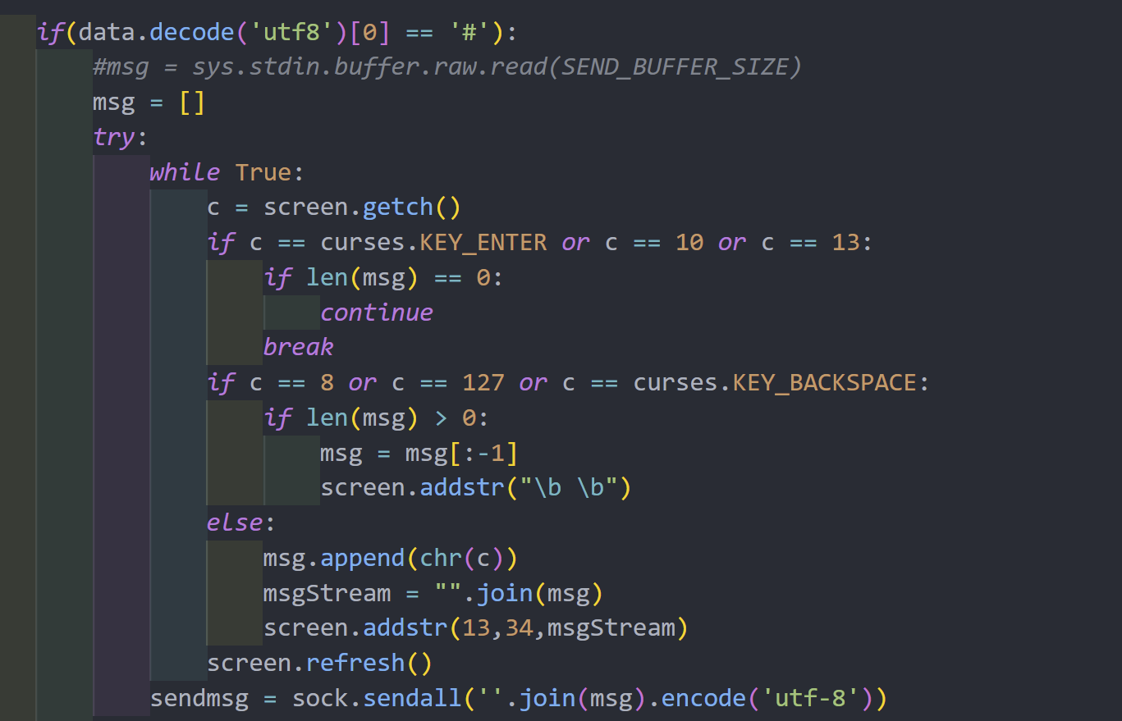
Client Side of Game

Slide 14
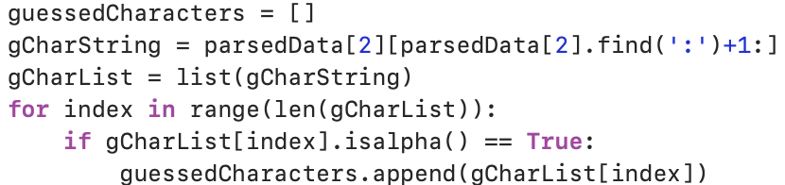
Issues encountered with Client
Receiving data packet from the server
Displaying game information to the terminal
When inputting information, letters had to be entered twice
Server was cutting off newline character
Guessed characters array cutting off characters
Figured out how to print it properly

Slide 15
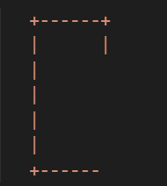
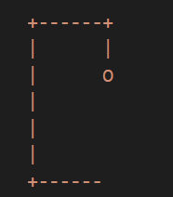
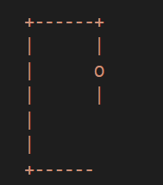
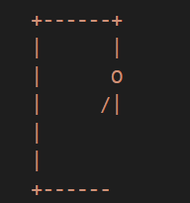
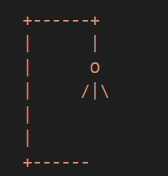
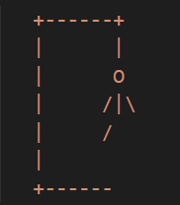
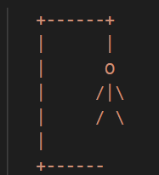
User Interface of the game Hangman
.

Slide 16
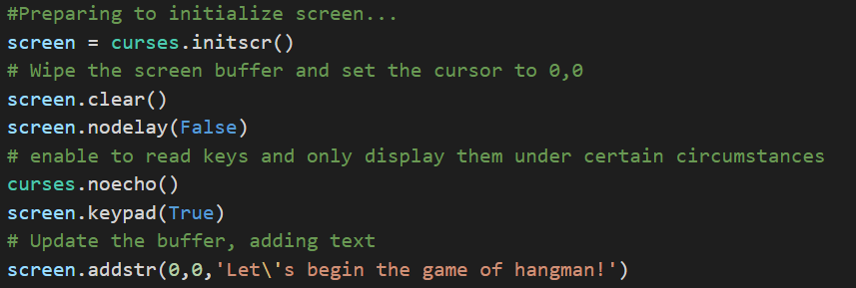
User Interface of the game Hangman : Curses
What is curses?
= library that supplies a terminal-independent screen-painting and keyboard-handling facility for text-based terminals such as the the Linux console
Why implement them?

Slide 17
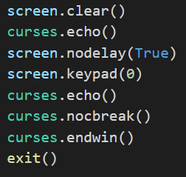

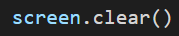


User Interface of the game Hangman : Curses
Some important curses functions:

Slide 18
Issues encountered with curses
If the window size was too small the client side would spit out a bunch of errors
The terminal wasn’t able to take in user input when implementing curses.
We were having issues displaying our guessed Characters list

Slide 19

Any Questions?

